Slide 1
Canny Edge Detection Filter
CE671 · INTRODUCTION TO REMOTE SENSING · IIT KANPUR
Concept, Development, Use and Application
with an application to coastline extraction from Sentinel-2 imagery (GeoEdge)
GROUP 15
Aayushman Kumar (Group Leader) · Shivakshi (Member-2)· Rajendra Singh (Member-3)
November 2026
Notes:
Introduce the group and the topic. Our topic has four parts: concept, development, use and application. The application is automatic coastline mapping from Sentinel-2 images.

Slide 2
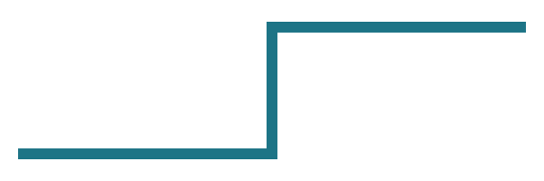
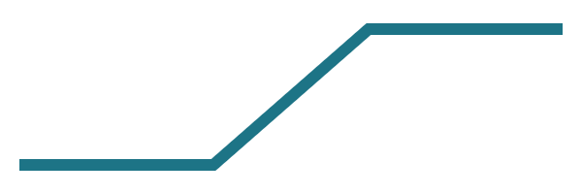
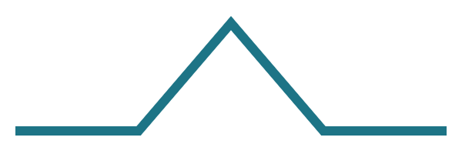
What is an edge?
CONCEPT
An edge is a place where brightness changes quickly over a short distance, such as where dark sea meets bright land.
Step edge
Ramp edge
Roof edge
Jumps in one pixel: black text on white paper. Rare in satellite images.
Rises over a few pixels: a coastline or a forest edge.
Rises to a peak and falls: a ridge or a wide road.
The coastline is a ramp edge: a 10 m shore pixel mixes water and land, so a good detector should mark only the middle of the ramp, as a one-pixel line.
The eye is built for edges too: Kuffler (1953); Hubel & Wiesel (1959), Nobel Prize 1981
2
Notes:
Edges show where one thing ends and another begins. Real edges in satellite images are mostly ramps. Mention the eye: retinal cells ignore flat areas and react to change; Hubel and Wiesel found cortex cells tuned to edge orientation.

Slide 3
How an edge filter works
CONCEPT
A small kernel slides over the image. Its numbers add up to zero. Sobel Gx:
Flat area: all pixels = 50
50 × (sum of kernel) = 50 × 0 = 0 → no edge
−1 | 0 | 1
−2 | 0 | 2
−1 | 0 | 1
Edge: water = 20 | land = 100
(−4) × 20 + (4) × 100 = 320 → strong edge
G = √(Gx² + Gy²) θ = tan⁻¹(Gy / Gx)
Gx finds vertical edges, Gy horizontal ones; a curved coastline needs both.
Gonzalez & Woods (2018); Sobel & Feldman (1968)
3
Notes:
An edge filter measures the first derivative of brightness. A flat area gives zero; a sudden change gives a large number. Edge strength G and direction theta come from the two Sobel kernels.

Slide 4
The five steps of the Canny filter
CONCEPT
1
2
3
4
5
Blur
Gradient
Thinning
Two thresholds
Hysteresis
Gaussian of width σ removes noise that makes false edges.
Sobel gives edge strength G and direction θ at each pixel.
Non-maximum suppression keeps only the peak across the edge.
Pixels above high are strong; between low and high, weak.
Weak pixels survive only if connected to strong ones.
Result: thin, connected lines, with isolated noise removed.
Canny (1986); Gonzalez & Woods (2018)
4
Notes:
Walk through the five steps. Blur amount sigma trades noise removal against detail. Thinning puts the edge at the middle of the ramp. Hysteresis keeps long weak edges whole because they touch strong parts.

Slide 5
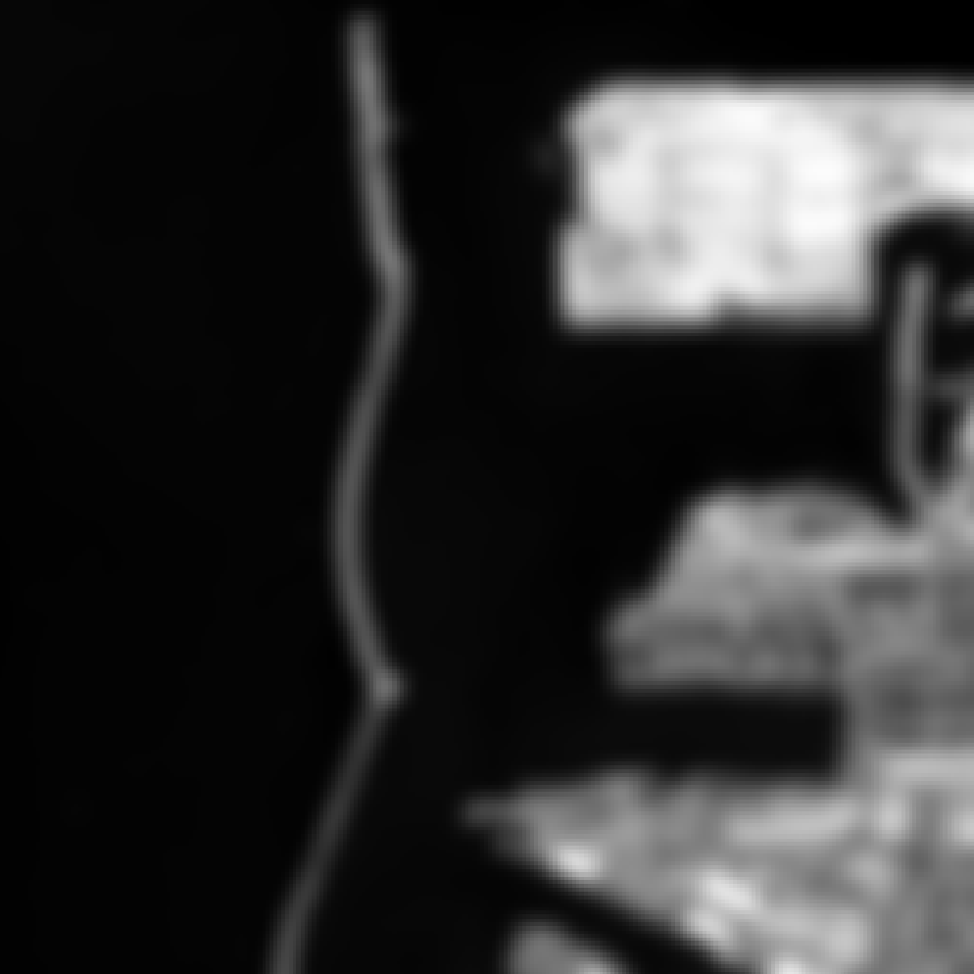
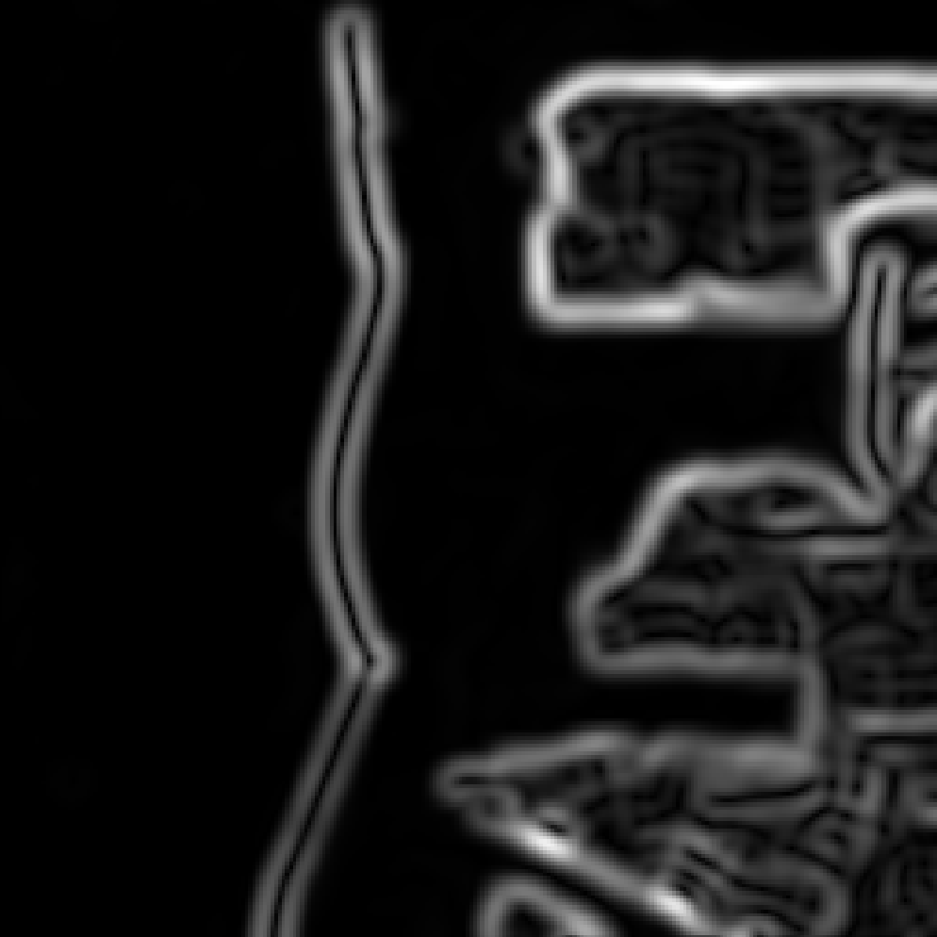
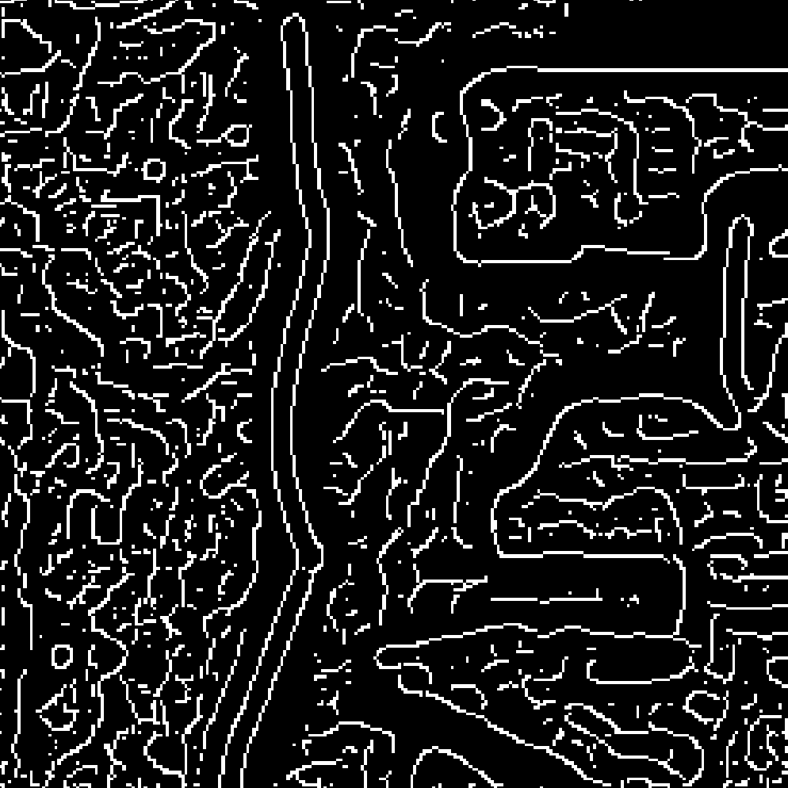
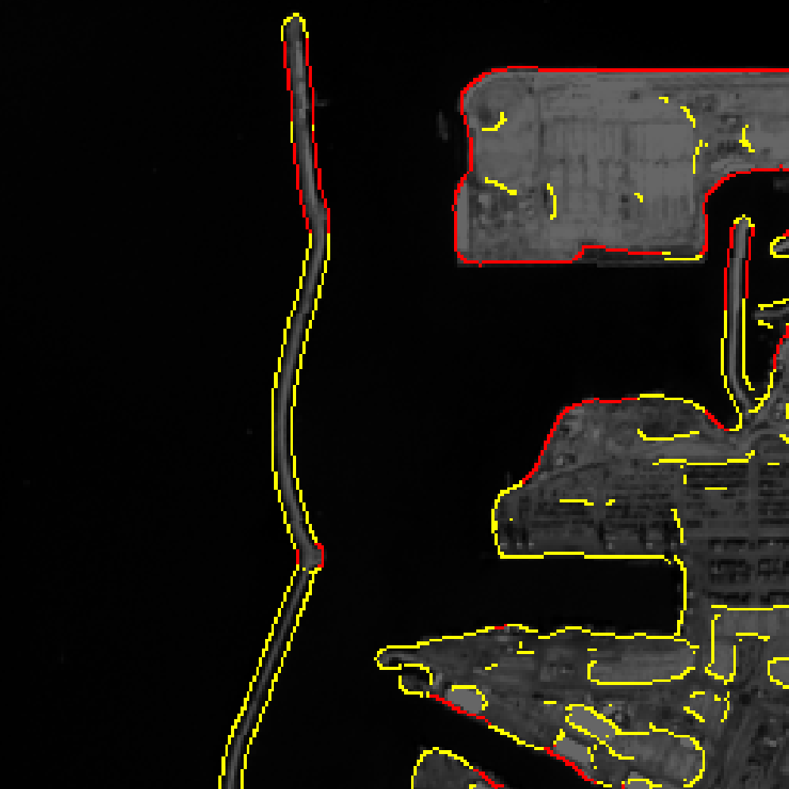
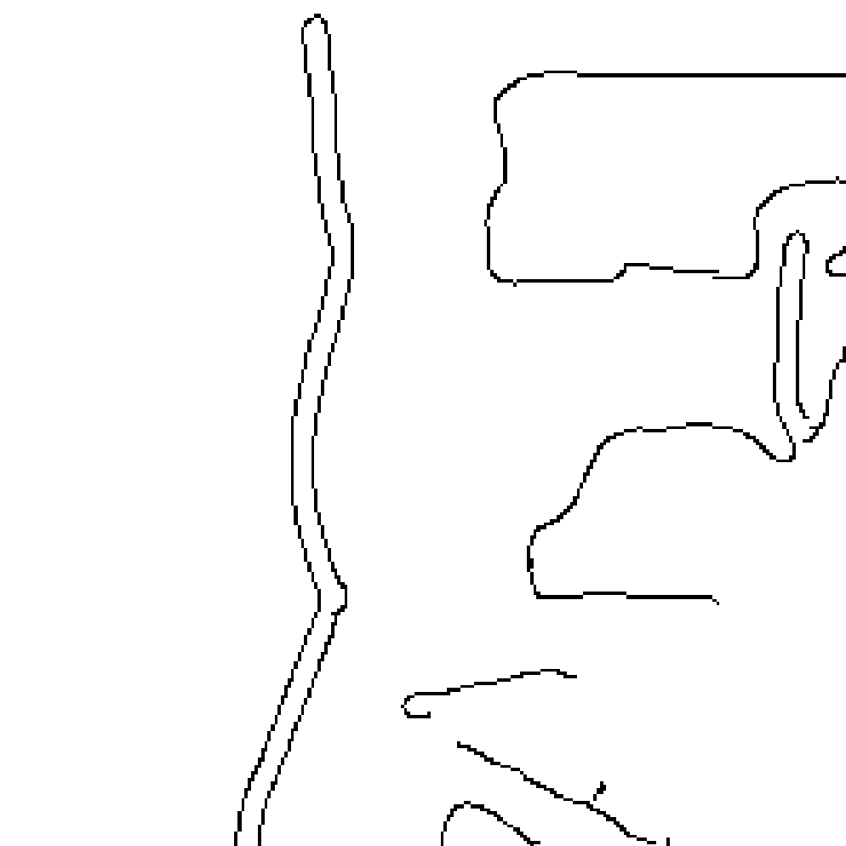
Canny step by step on Ashdod port
CONCEPT
1 · Blur
2 · Gradient
3 · Thinning
4 · Thresholds
5 · Hysteresis
Noise smoothed, σ = 3
Edge strength G: wide bands
One-pixel lines, still noisy
Strong (red), weak (yellow)
Final connected edges
Grayscale input, σ = 3, high threshold 0.50: hysteresis keeps the breakwater whole and drops texture inside the town.
Data: SWED, UK Hydrographic Office; Sentinel-2, Copernicus/ESA. Not to be used for navigation.
5
Notes:
Our own run of the five steps on the Ashdod test image, left to right. After thinning there are many lines in the town; after the two thresholds and hysteresis only connected outlines remain.

Slide 6
Edge filters before Canny
DEVELOPMENT
Filter | Year | Main idea | Main problem
Roberts | 1963 | Very small 2 × 2 kernel | Easily disturbed by noise
Sobel | 1968 | 3 × 3, extra weight on centre row | Thick edges
Prewitt | 1970 | 3 × 3, equal weights | Noise and thick edges
Laplacian | – | Second derivative, all directions | Very sensitive to noise
LoG (Marr–Hildreth) | 1980 | Blur first, then Laplacian | Less noise, rounded corners
They only highlight edges. Lines are thick and noisy, and break where the edge fades. None decides where the edge really is.
Gonzalez & Woods (2018); Jain et al. (1995); Marr & Hildreth (1980)
6
Notes:
Twenty years of small kernels. Each improved on noise or weighting, but all produce a strength map, not a decision about where the edge is.

Slide 7
Canny (1986): designed from three goals
DEVELOPMENT
Not "which kernel?" but "what should a perfect edge detector do?"
Good detection
Good localization
One response
Find the real edges, ignore noise.
Put each edge in the right place.
Mark each edge once, one pixel wide.
Result: the best filter is close to the first derivative of a Gaussian, i.e. blur, then measure change.
Trade-off: more blur finds edges more reliably but places them less exactly, so σ must be chosen.
Canny, J. (1986). IEEE TPAMI 8(6), 679–698
7
Notes:
Canny wrote each goal as a formula and searched for the filter that scores best on all three. The Gaussian derivative is about 20 percent below the exact optimum but much faster, so he used it. Today it is built into OpenCV and MATLAB.

Slide 8
Adaptive Canny: thresholds from the image
DEVELOPMENT
Problem
GeoEdge approach
Classic Canny needs hand-picked thresholds, and the best value changes with the scene.
Derive the two thresholds automatically with Otsu's method on the gradient-magnitude histogram of each scene.
Ashdod best high threshold: 0.50 Grayscale, 0.55 NDWI, 0.30 MNDWI.
No manual tuning per image.
Result
Otsu-adaptive vs hand-tuned Canny on Ashdod: F1 [__] vs 0.92
Otsu (1979); GeoEdge Track A
8
Notes:
Placeholder for Track A. Fill in the Otsu rule actually implemented and the measured F1 of the adaptive version. Report measured numbers only.

Slide 9
Scalable Canny for full Sentinel-2 scenes
DEVELOPMENT
A full multi-band scene is over 1.2 GB and 100 million pixels: too large to process in one piece.
Tiling with halo
C++20 SIMD core
pybind11
Process the scene block by block, with overlap padding so edges join across tiles. Memory stays bounded.
Separable Gaussian, vectorised Sobel, NMS, hysteresis and 8-connected tracking.
The C++ core is called from Python, alongside GDAL / Rasterio for GeoTIFF input and output.
Design targets: peak memory < 250 MB; ≥ 4.2× faster than a Python baseline. Measured values: slide 16.
GeoEdge Track A (README, AGENTS.md)
9
Notes:
Track A slide. These are design goals from the README; present them as targets, and show measured numbers on the performance slide.

Slide 10
Where Canny is used
USE
Medicine
Cars and robots
Outlining bones, organs and tumours in X-ray, CT and MRI.
Finding lane markings and the outlines of obstacles.
Factories and scanners
Remote sensing
Checking products for cracks; finding page and number-plate edges.
Buildings, roads, fields, rivers and coastlines; e.g. airport runways via Canny + Hough.
Coastline example: Liu & Jezek (2004) used Canny to find mixed shore pixels, then thresholded water vs land, accurate to about one pixel on Landsat 7.
Gonzalez & Woods (2018); Lillesand et al. (2015); Liu & Jezek (2004)
10
Notes:
Canny is simple, fast and reliable, so it is used everywhere. In coastline mapping, Liu and Jezek removed the Canny shore band before building the histogram, which made the water and land peaks clean and the threshold reliable.

Slide 11
Canny in remote sensing: the GeoEdge pipeline
USE
Water index first
1
Sentinel-2 scene → tiles with halo padding
NDWI = (B3 − B8) / (B3 + B8)
2
NDWI enhancement layer
Water reflects almost no near-infrared, so water turns bright and land dark. MNDWI uses B11 (SWIR, 20 m) instead of B8.
3
Gaussian blur → Sobel gradient → NMS (C++)
McFeeters (1996); Xu (2006)
4
Otsu-based hysteresis thresholds
5
8-connected tracking → binary edge GeoTIFF
GeoEdge README: technical architecture
11
Notes:
The water index suppresses gradients inside the land, such as buildings and fields, before Canny runs. The pipeline keeps memory bounded by working tile by tile.

Slide 12
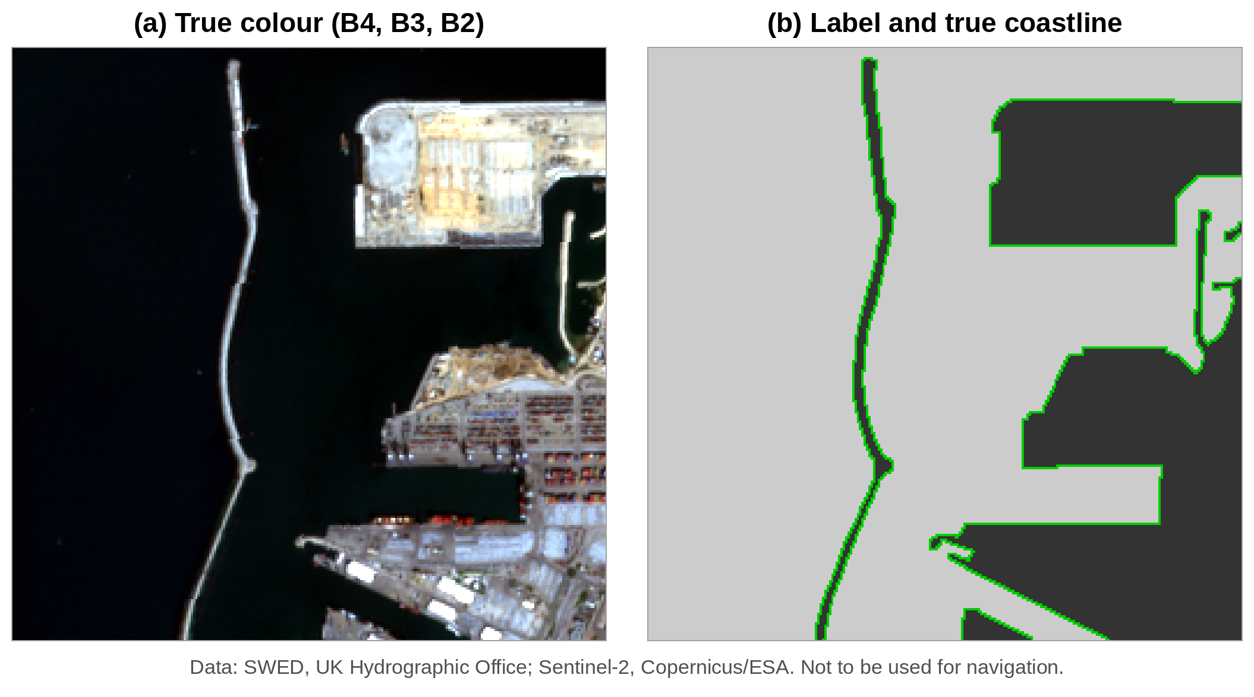
Data and method
APPLICATION
Sentinel-2, SWED test set (UK Hydrographic Office)
Ashdod port, Israel, 15 Feb 2020: 256 × 256 px at 10 m
Truth: hand-drawn mask; coastline = 1,730 px
Inputs: Grayscale, NDWI, MNDWI
Fair test: best setting per filter; 210 Canny runs
Scoring (2-pixel = 20 m tolerance): Precision = correct ÷ found, Recall = found ÷ coastline, F1 = 2PR ÷ (P + R)
Data: SWED, UK Hydrographic Office (Seale et al., 2022); Sentinel-2, Copernicus/ESA. Not to be used for navigation.
12
Notes:
All work in MATLAB Online with the edge function. Green line in the label is the true coastline: every water pixel with a land neighbour. The tolerance allows for the hand-drawn mask and the ramp width.

Slide 13
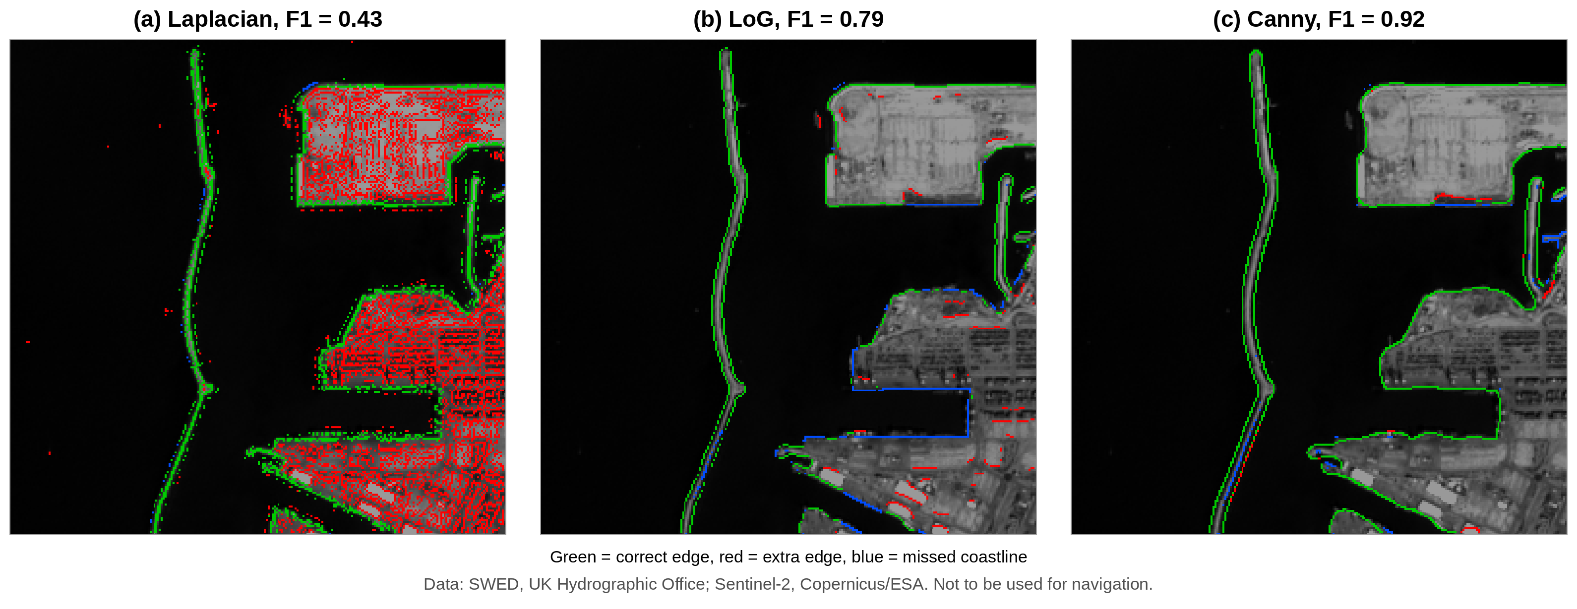
Six filters on Ashdod: Canny scores highest
APPLICATION
Filter | P | R | F1
Roberts | 0.78 | 0.83 | 0.80
Sobel | 0.83 | 0.80 | 0.81
Prewitt | 0.83 | 0.80 | 0.82
Laplacian | 0.28 | 0.98 | 0.43
LoG | 0.79 | 0.79 | 0.79
Canny | 0.94 | 0.91 | 0.92
Green = correct, red = extra, blue = missed coastline
Laplacian finds almost all the coastline but also every building; LoG misses dock edges. Canny gives clean, connected outlines.
Grayscale input, best setting each. Data: SWED, UKHO; Sentinel-2, Copernicus/ESA. Not to be used for navigation.
13
Notes:
Canny is best in both precision and recall. Roberts, Sobel and Prewitt have broken lines along the docks and extra pieces on roofs.

Slide 14
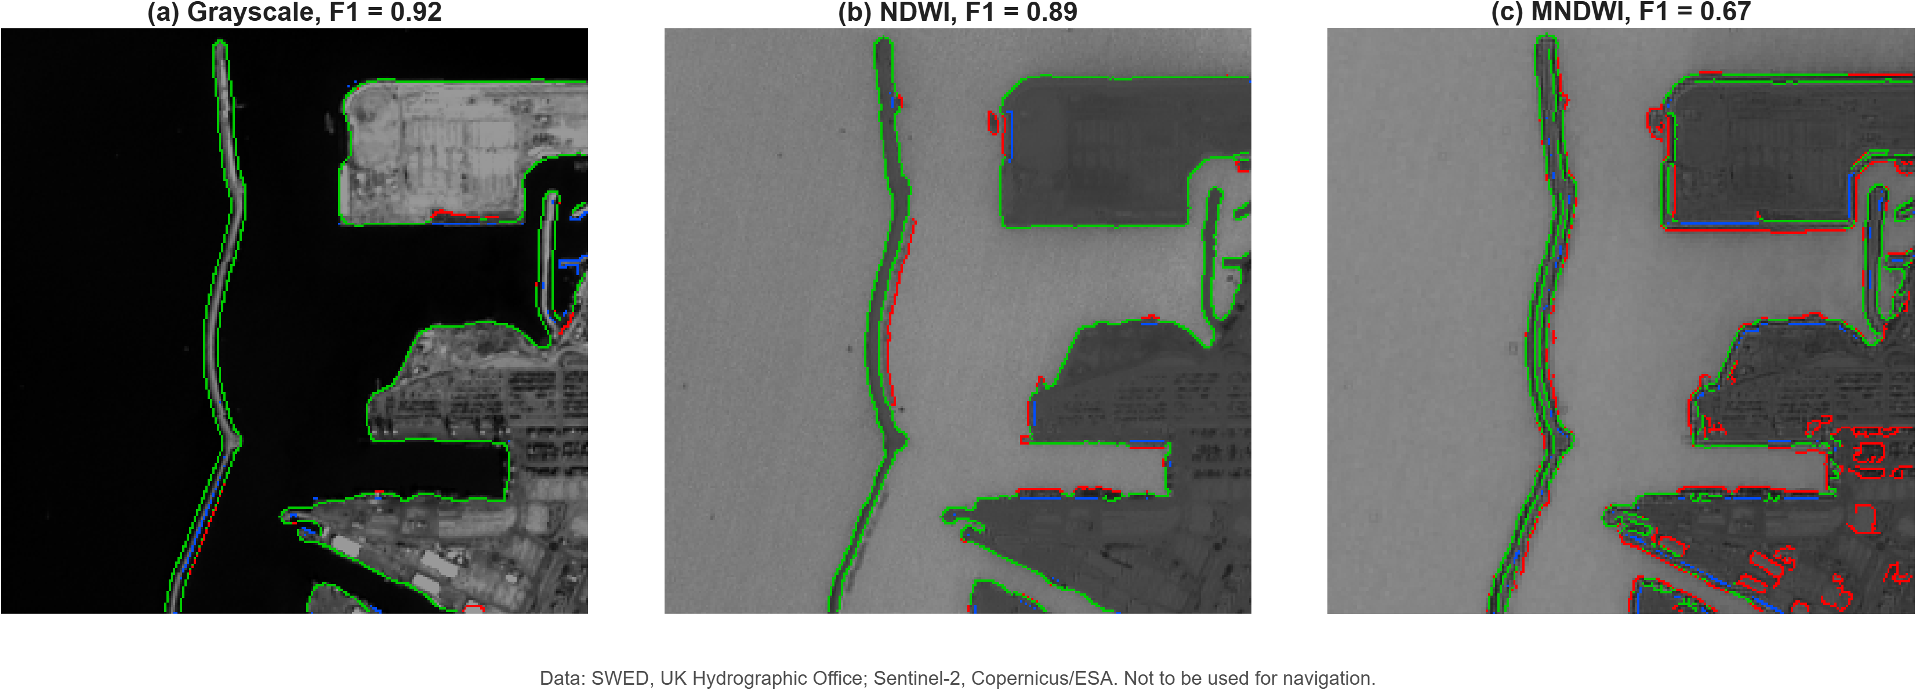
Effect of the input image
APPLICATION
F1 | Gray | NDWI | MNDWI
Roberts | 0.80 | 0.82 | 0.78
Sobel | 0.81 | 0.85 | 0.74
Prewitt | 0.82 | 0.85 | 0.73
Laplacian | 0.43 | 0.28 | 0.56
LoG | 0.79 | 0.76 | 0.62
Canny | 0.92 | 0.89 | 0.67
NDWI helps the simple filters; Grayscale is best for Canny in clear water; MNDWI is blocky (20 m band).
Data: SWED, UK Hydrographic Office; Sentinel-2, Copernicus/ESA. Not to be used for navigation.
14
Notes:
At Ashdod the sea is clear and dark, so grayscale already has strong contrast. NDWI should help more for muddy water or green land. The raw-band row is to be filled from the new runs.

Slide 15
Beyond Ashdod: other coast types
APPLICATION
Scene | SWED tile | Canny F1 | Best input
Urban port (Ashdod) | T36SXA | 0.92 | Gray
Clean sandy beach | [__] | [__] | [__]
Turbid estuary | [__] | [__] | [__]
[QGIS map]
Question: do Ashdod's settings (σ = 3, high = 0.50) still work on new coasts, or must they be re-tuned?
Data: SWED, UK Hydrographic Office; Sentinel-2, Copernicus/ESA. Not to be used for navigation.
15
Notes:
Placeholder for the new scenes and QGIS map. Fill tile IDs and F1 from the same MATLAB script. If time allows, also report Canny with Ashdod's fixed settings to test generalisation.

Slide 16
Performance: runtime and memory
APPLICATION
Metric | Python / OpenCV baseline | GeoEdge (C++) | Target
Runtime, 100 M pixels | [__] s | [__] s | < 12 s
Throughput | [__] Mpx/s | [__] Mpx/s | –
Peak memory | [__] MB | [__] MB | < 250 MB
Speed-up | 1.0× | [__]× | ≥ 4.2×
Same input, same output edges; only measured values reported.
GeoEdge benchmarks (wall-clock time, tracemalloc)
16
Notes:
Placeholder for Track A benchmarks. Fill only with measured numbers, and say on which machine and image size they were measured.

Slide 17
Why Canny works, and where it fails
DISCUSSION
Why it wins
Choice of input
Limitations
Blur removed sea and town texture; thinning centred each edge; hysteresis kept the long, weak breakwater whole.
Clear, dark sea: grayscale is enough. NDWI should help with muddy water or green land. MNDWI is limited by its 20 m band.
Also marks docks and buildings. One scene only, tuned and scored on the same image, so scores may be optimistic.
Possible fix: keep only large connected sea and land regions (Liu & Jezek, 2004).
Group 15 · CE671
17
Notes:
The results match Canny's three goals. Add failure modes from the new scenes here when available.

Slide 18
Canny turns a noisy coastline into one thin, connected line.
CONCLUSION
Concept: blur, gradient, thinning, two thresholds, hysteresis.
Development: from 2 × 2 kernels (1963) to goal-driven design (1986), now adaptive and scalable.
Use: medicine to remote sensing; key step in automatic coastline mapping.
Application: best of six filters on Ashdod, F1 0.92 vs 0.43–0.82.
Group 15 · CE671
18
Notes:
Close with the main weakness: Canny finds every edge, including docks and buildings, so its output still needs checking against the real coastline.

Slide 19
Contributions and references
Contributions
Key references
Aayushman Kumar (Group Leader): [__]
Canny, J. (1986). A computational approach to edge detection. IEEE TPAMI, 8(6), 679–698.
Shivakshi: [__]
Gonzalez, R. C., & Woods, R. E. (2018). Digital Image Processing (4th ed.). Pearson.
Rajendra Singh: [__]
Liu, H., & Jezek, K. C. (2004). Int. J. Remote Sensing, 25(5), 937–958.
McFeeters, S. K. (1996). NDWI. Int. J. Remote Sensing, 17(7), 1425–1432.
Seale, C., et al. (2022). SWED. Remote Sensing of Environment, 278, 113044.
Marr, D., & Hildreth, E. (1980). Theory of edge detection. Proc. R. Soc. Lond. B, 207, 187–217.
Code: github.com/AayushmanKumar/GeoEdge
19
Notes:
Fill each member's role, matching Section 6 of the paper.

